Slide 1
Lesson 4: Overall Review and Assessment
Fe Maidens Programming 2017-2018
Notes:
For all of the review slides, quickly address each thing we’ve learned, and ask rookies if they want any clarification for any of the topics

Slide 2
Logic Review
Before we code, it’s a good idea to write pseudocode, which is basically outlining the steps we need to follow in order to get to our goal. During our first lesson, we walked through the steps of making a peanut butter and jelly sandwich, which was an example of writing pseudocode.
We also learned about booleans, which is a type of variable that can either be true or false. These booleans can be used with conditionals, also known as if/else statements, that execute code if certain requirements are fulfilled.

Slide 3
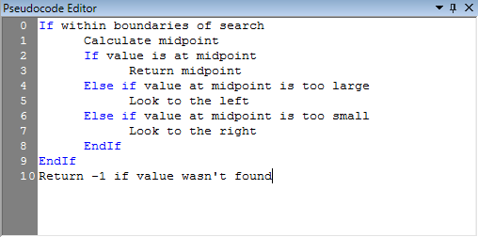
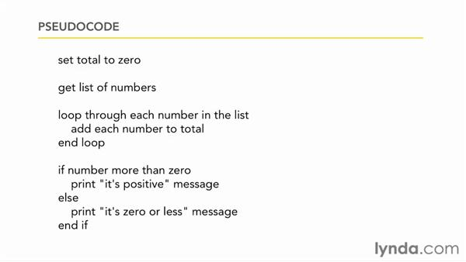
Sample Pseudocode

Slide 4
Coding Review
Code is made of information and processes. In Java, information is stored in variables, which have a type, name, and value. Processes are stored in methods, which have a return type, name, encapsulation (private/public), and parameters.
Java is an object-oriented programming language. To make your own kind of object, you can make a class, which is a blueprint for creating that object. To make an instance of a class, we use a constructor.
When writing robot code, FRC provides us with an API that gives us prewritten classes, methods, and constructors.

Slide 5
Java Syntax Review
All statements end with a semicolon.
Variable and object declaration: [type] [name];
int x;
String hello;
Variable instantiation: [name] = [value];
x = 10;
Object instantiation: [name] = new [type]([parameters]);
hello = new String(“hello”);
Method creation: [encapsulation] [return type] [name] ([parameters]){ [content] }
public int sum(int num, int num2) { return num + num2; }

Slide 6
Robot Review
We use code to control many different parts on the robot, like Talons, which are speed controllers that control the motors, and Solenoids, which control pistons. We also take input from Joysticks for things like driving. All of the code that we write is loaded onto the roboRIO, which is the brain of the robot and allows our code to actually be executed on the robot.
When writing robot code, FRC provides us with an API that gives us prewritten classes, methods, and constructors, that you can find at
http://first.wpi.edu/FRC/roborio/release/docs/java/

Slide 7
Writing Pseudocode:
Next, you will be writing some code to control different parts of the robot!
Once we show you a prompt, you will have about 10 minutes to write pseudocode as a group and do a little research if you want to. You will use this pseudocode to write the actual code for each prompt alone at home.
You will have until this Saturday at 11:59 to email your solutions to the three prompts to us at aliz@bxscience.edu and shaot@bxscience.edu.
Feel free to use the API and the internet if you want to.
Even if you’re not sure about your answer, please send it to us anyway! And if you’re not sure how to code it, you can explain how you would answer the prompt to us as well.
Notes:
Make sure they each individually have the pseudocode from the group work. Stress that the assessment is individual. Also have them write down the gist of each prompt
Each prompt will be scored out of 5 points

Slide 8
Writing Code Part 1:
Write the import statements for the RobotDrive and Joystick classes.
Write a method called drive() that will allow somebody to control the robot in tank drive using a controller.
Given:
-The RobotDrive has been defined as TankDrive.
-The robot will be controlled by a Joystick defined as atkJoy.
-The left side of the robot will be controlled by axis 1.
-The right side of the robot will be controlled by axis 5.
Notes:
//imports (1 point)
import edu.wpi.first.wpilibj.Joystick; import edu.wpi.first.wpilibj.RobotDrive;
//creation of method (1 point)
public void drive(){
//use of API to get input from axis (1 point)
double left = atkJoy.getRawAxis(1);
double right = atkJoy.getRawAxis(5);
//use of tankDrive (1 point)
TankDrive.tankDrive(left, right);
}
//Overall concept (1 point)

Slide 9
Writing Code Part 2:
Write the extend() and retract() method that will make a piston extend and retract respectively.
Given:
-The class has has already been made.
-The piston is controlled by a double solenoid.
-The double solenoid is defined as sol.
Notes:
//creation of methods (2 point)
public void extend(){
//use of set method (1 point)
//use of DoubleSolenoid.Value.kForward (1 point)
sol.set(DoubleSolenoid.Value.kForward);
}
public void retract(){
sol.set(DoubleSolenoid.Value.kReverse);
}
//Overall concept (1 point)

Slide 10
Writing Code Part 3:
Write a method called setMotor() that takes a parameter speed that allows you to set a motor’s speed to whatever you want. Then, call this method to set the motor to half speed forward.
Given:
-The motor is controlled by a Talon called leftMotor.
-You don’t need to reference any object when calling the setMotor() method.
Notes:
//creation of method (1 point) and parameter (1 point)
public void setMotor(double speed){
//use of set with parameter (1 point)
leftMotor.set(speed);
}
//calling the method (1 point)
setMotor(0.5);
//overall concept (1 point)

Slide 11

Resources for the Future
Since this is the last lesson, we want to let you guys know about other ways to continue to code and to learn about computer science in general.
We’re really lucky that Bronx Science offers a lot of computer science classes that you can take, like Computer Science Projects, AP Computer Science, Game Programming, and App Development.
We also have after school programs like Bronx Science Hackers, Desktop Robotics, and MakerSpace where you can learn more about robotics and engineering.

Slide 12
Resources for the Future
There are also a lot of opportunities outside of school that you can use to learn more about computer science!
Organizations like Girls Who Code run summer programs that teach you a variety of topics over 6 weeks. (www.girlswhocode.com)
There are also a bunch of websites where you can continue learning Java, like Coding Bat (www.codingbat.com), or learn other languages, like Codecademy (www.codecademy.com)
An organization called CodeNow is also having workshops in November and December, and applications close October 26. You can find out more at www.codenow.org/apply
Notes:
Also mention if they don’t make the team this year, don’t let it discourage them from applying again next year

